Slide 1
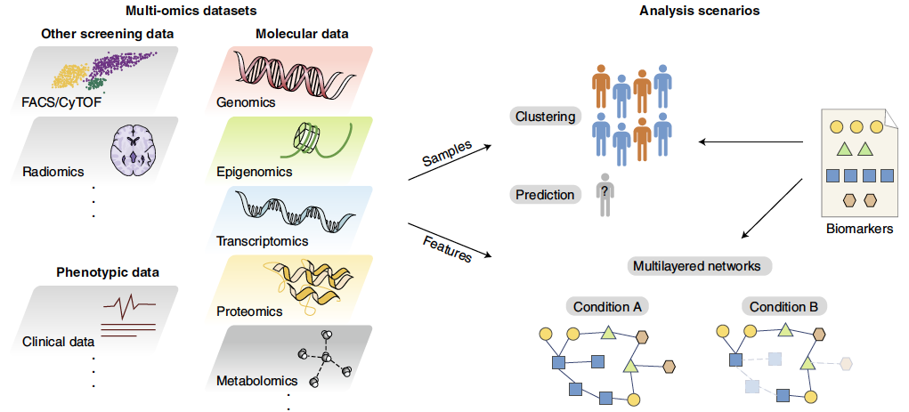


April 11, 13, 18, 20 2023
Figure from Tarazona et al. (2021) Nature Computational Science

Slide 2
Selective Introduction of Multi-Omics Analysis
American Statistical Association (ASA):
Section on Statistics in Genomics and Genetics (SSGG)
Directors:
George Tseng (University of Pittsburgh)
Katerina Kechris (University of Colorado Denver)
Instructors:
Session 1: Wenjia Wang (University of Pittsburgh)
Session 2: Sierra Niemiec (University of Colorado Denver)
Session 3: Jack Pattee (University of Colorado Denver)
Session 4: Rick Chang (University of Pittsburgh)
Acknowledgement of support from SSGG:
Nancy Zhang (Section Chair 2023)
Michael C. Wu (Past Chair 2022)
Yijuan Hu (Treasurer)
Yuchao Jiang (Communications Officer)

Slide 3
Housekeeping
Questions
Ask questions in chat
One lecturer will teach, other lecturers will monitor the chat
You can also send questions privately to a particular lecturer if you prefer
Video recording
Videos recording will be shared through Section on Statistics in genomics and genetics
GitHub site: TBD
Break
We will have a 5 minutes break for each lecture.
Notes:
Encourage everyone to turn the video on

Slide 4
Short Course Overview
Multi-omics studies now common in small groups + large consortium studies
Many statistical and computational challenges
Learning objectives
Learn about the landscape of multi-omics problems and analysis methods.
Understand some of the theoretical justification behind selected multi-omics methods.
Gain hands-on experience with multi-omics analysis software and data applications.

Slide 5
Short Course Overview
Prerequisites: basic knowledge of statistics, molecular biology, genetics, and familiarity with R programming
Each session has 2 parts
1st part: motivation, basic principles, representative tools, and examples
2nd part: real-time lab session - provide hands-on experience and lasting take-home messages
Lab sessions:
Reproducible examples, relevant data and annotated code through GitHub
Can practice within class or review at their own pace after the short course.

Slide 6
Outline
Lecture 1 (Wenjia Wang)
Brief introduction
Example method: MetaOmics
Lecture 2 (Sierra Niemiec)
Unsupervised clustering of multi-omics data
Example method: MOVICS
Lecture 3 (Jack Pattee)
Dimension reduction for multi-omics data
Example method: JIVE
Lecture 4 (Rick Chang)
Multi-omics causal mediation analysis
Single cell multi-omics analysis
Example methods: HIMA, Seurat
Notes:
We have condensed the materials a bit

Slide 7











Section on Statistics in Genomics and Genetics
https://bit.ly/3lK4Ja5
https://bit.ly/3DKXyos
https://bit.ly/3AOZBWy
https://bit.ly/3p2aK49
https://bit.ly/30jXvBp

Slide 8
Lecture 1 Overview of Multi-Omics Data Analysis and Horizontal Data Integration
April 11, 2023
Instructor: George Tseng
Wenjia Wang

Slide 9
Outline
Background of Multi-Omics Data Integration
Why integrate omics data?
Multi-omics data source
Common analysis themes and examples
Overview of omics data integration
Methods for Vertical Multi-Omics Data Integration
Parallel integration approaches
Hierarchical integration approaches
Horizontal Omics Data Integration
Lab Session: MetaOmics

Slide 10
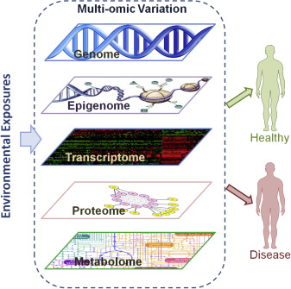
Why Integrate Omics Data?
Use of two or more omics data sets (e.g., epigenomics, transcriptomics, metabolomics)
Confirm or gain new insights that may not be possible using single-omics data
Attain systems perspective for biological processes and disease mechanisms
Sun & Hu (2016) Advances in Genetics
Notes:
https://www.sciencedirect.com/science/article/abs/pii/S0065266015000516
Yan V. Sun, Yi-Juan Hu,
Chapter Three - Integrative Analysis of Multi-omics Data for Discovery and Functional Studies of Complex Human Diseases,
Editor(s): Theodore Friedmann, Jay C. Dunlap, Stephen F. Goodwin,
Advances in Genetics,
Academic Press,
Volume 93,
2016,
Pages 147-190,

Slide 11
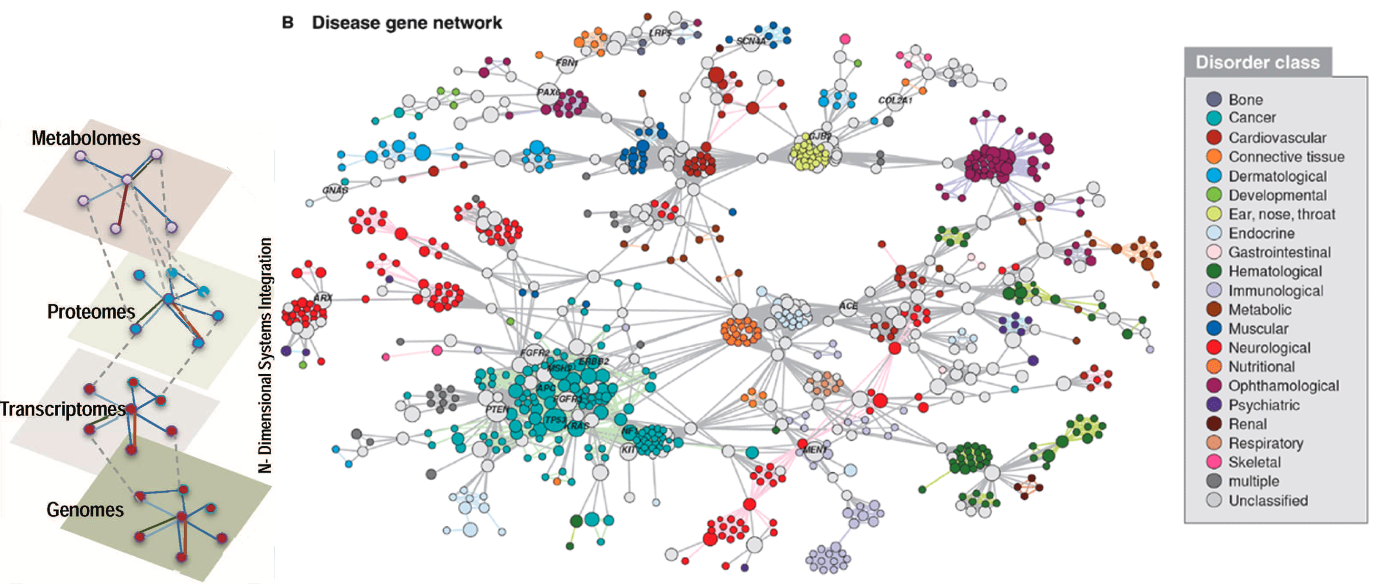
Why Integrate Omics Data?
Slides for statistical machine learning short course in Sixth Seattle Symposium in Biostatistics by Ali Shojaie.

Slide 12
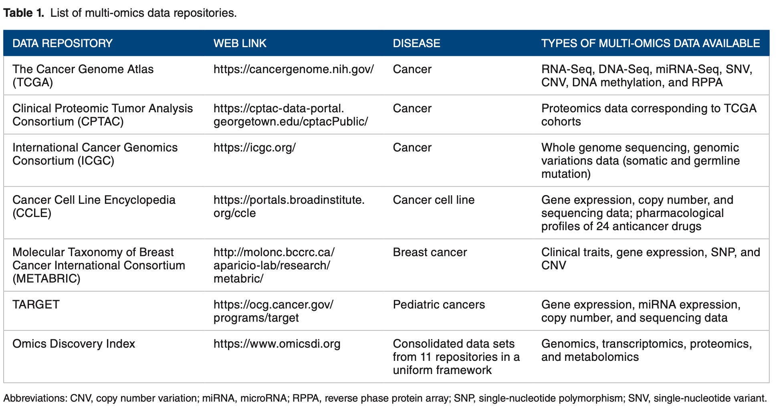
Public Data Sources
Subramanian et al. (2020) Bioinformatics and Biology insights

Slide 13
Types of Multi-Omics Data Analysis
Experimental design
Data Generation
Preprocessing
Association analysis
Dimension reduction
Clustering
Gene set enrichment
analysis
Classification
Regulatory network

Slide 14
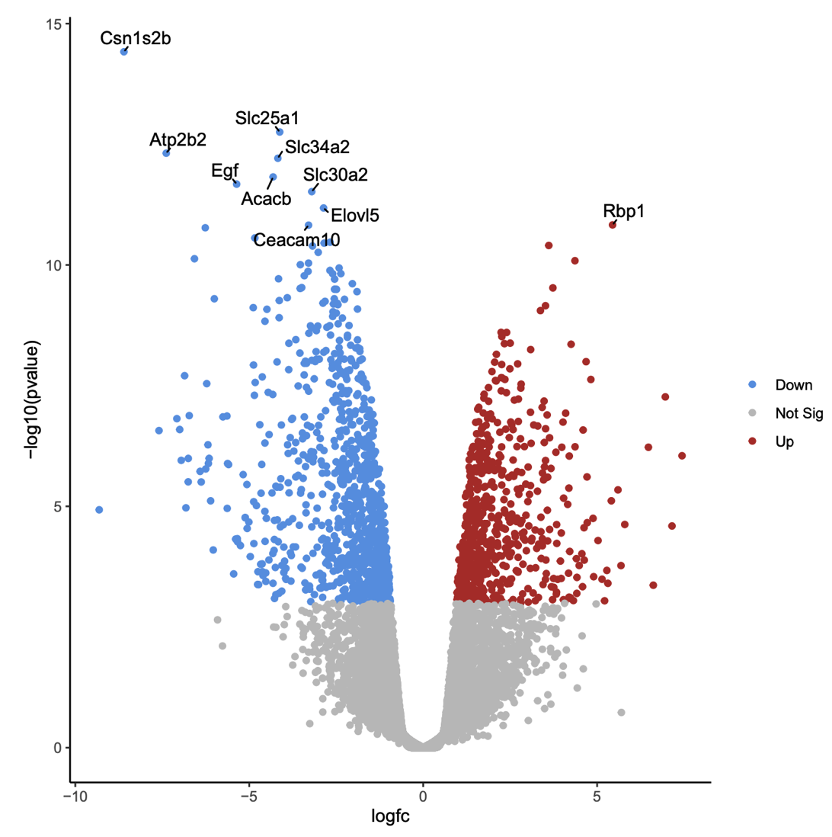
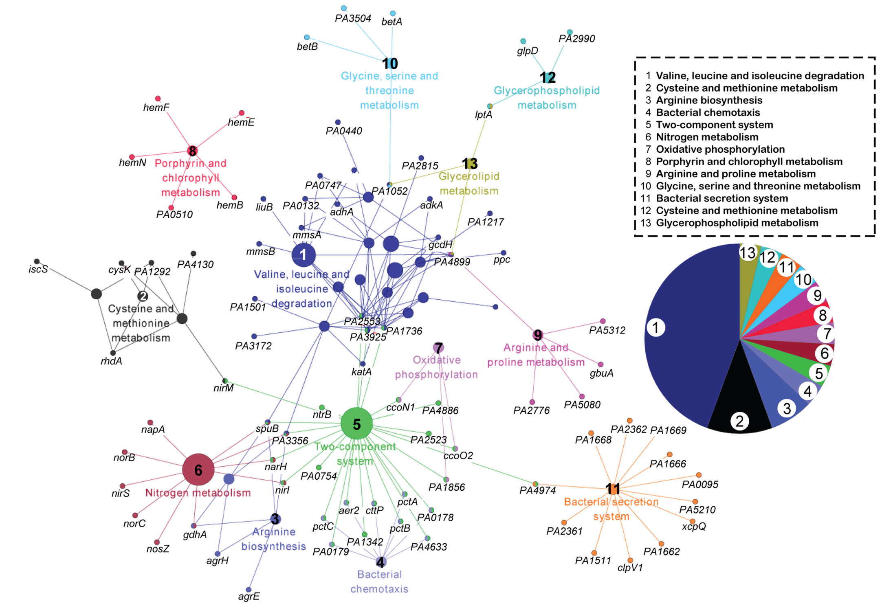
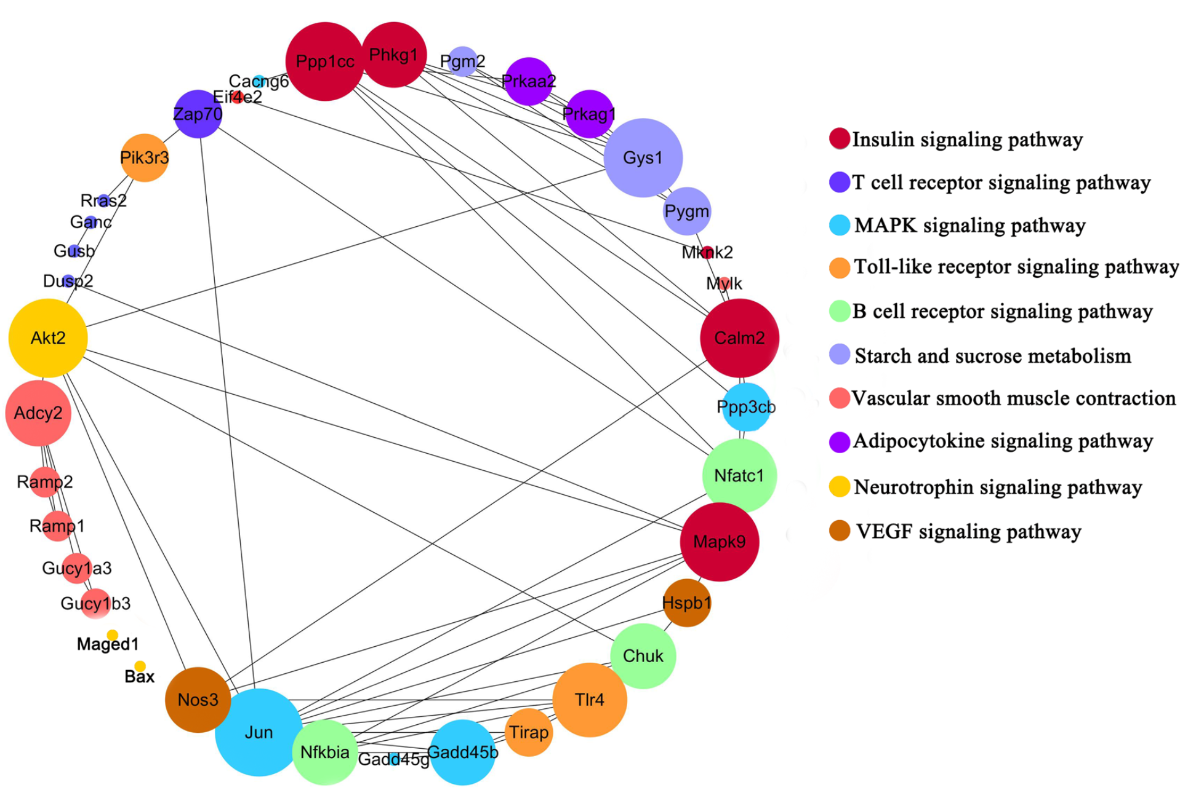
Types of Multi-Omics Data Analysis
Experimental design
Data Generation
Preprocessing
Association Analysis
Dimension reduction
Clustering
Gene set enrichment
analysis
Classification
Regulatory network
Gu et al. (2021) Sci Rep; Zhao et al. (2017) Front Microbiol.

Slide 15
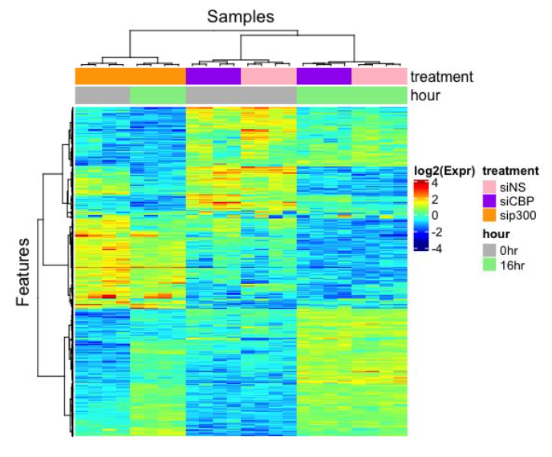
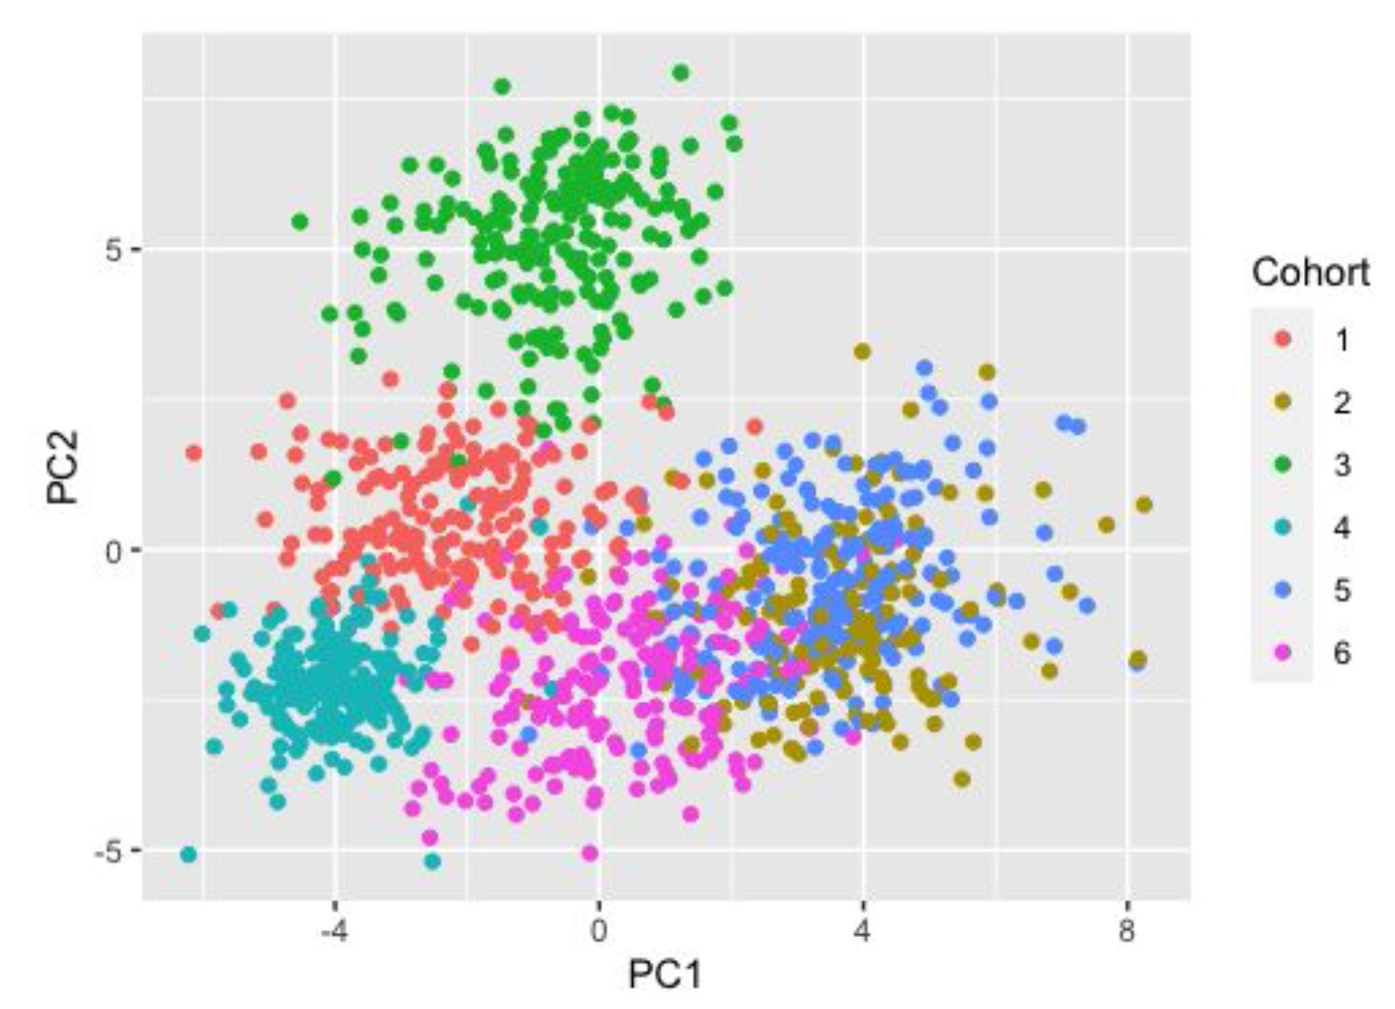
Types of Multi-Omics Data Analysis
Experimental design
Data Generation
Preprocessing)
Association Analysis
Dimension reduction
Clustering
Gene set enrichment
analysis
Classification
Regulatory network

Slide 16
When to Integrate?
Early integration (concatenated or separated)
2. Late integration (analyze separately, then integrate)
Omics 1
Omics 2
Omics 3
Multi-Omics
Result
Omics 1
Omics 2
Omics 3
Analysis
Single-Omics Specific Results
Multi-Omics
Result

Slide 17
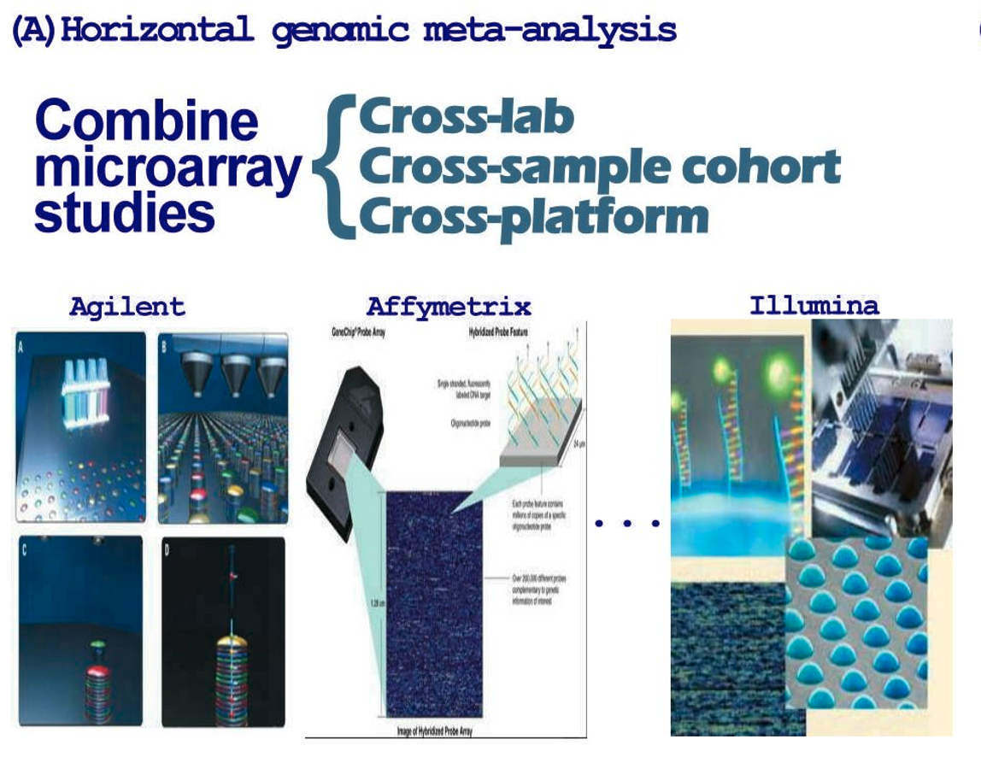
Horizontal Multi-Omics Integration
Same kind of omics data on K different samples or subject cohorts (GWAS, gene expression, methylation, eQTL…)
Increase statistical power and generate robust discoveries
D₁
D₂
….
D_{K}
LECTURE 1: Combining multiple genomic studies for horizontal meta-analysis and data integration (MetaOmics)
G genes×
S₁ samples
G genes×
S₂ samples
G genes×
S_{K} samples
Tseng et al. (2012) Nucleic Acids Res.

Slide 18
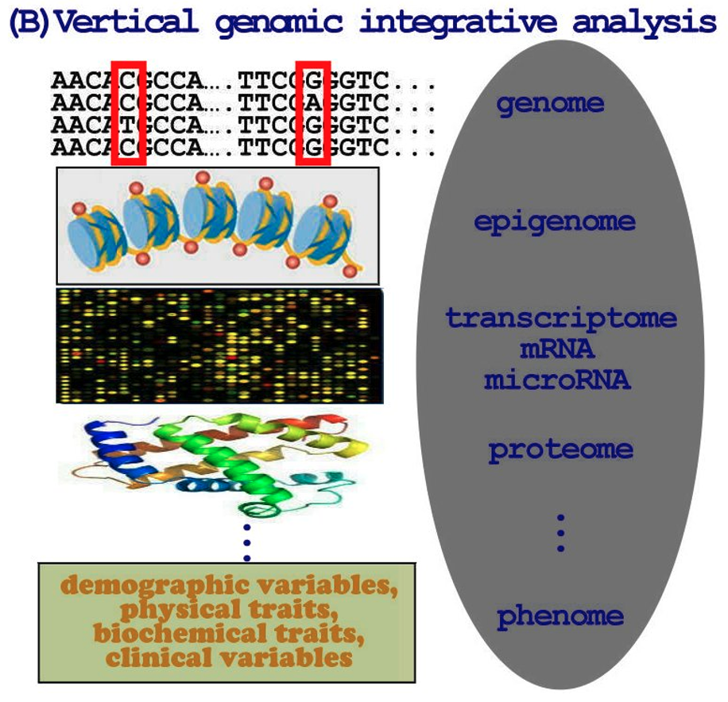
Vertical Multi-Omics Integration
Same samples or subject cohort analyzed using different omics technology
Understand the complex biology and diseases systematically and holistically
G₁ SNP×
S samples
E₁
G₂ gene expression ×
S samples
E₂
…
G_{H} miRNA×
S samples
E_{H}
Tseng et al. (2012) Nucleic Acids Res.

Slide 19
Outline
Background of Multi-Omics Data Integration
Why integrate omics data?
Multi-omics data source
Common analysis themes and examples
Overview of omics data integration
Methods for Vertical Multi-Omics Data Integration
Parallel integration approaches
Hierarchical integration approaches
Horizontal Omics Data Integration
Lab Session: MetaOmics

Slide 20
Vertical Multi-Omics Integration
Hierarchical integration incorporates prior knowledge of regulatory relationship among different omics data
Hierarchical integration can more closely reflect the biological nature of multidimensional data, but it lacks generalizability.
Parallel integration treat omics measurements from different platforms equally
Most methods are parallel, since it can be easily generalized to arbitrary number & types of omics data.
Vertical Integration Scheme:
Parallel vs Hierarchical Integration
Wu et al. (2019). High Throughput; Hasin et al. (2017). Genome Biology.

Slide 21
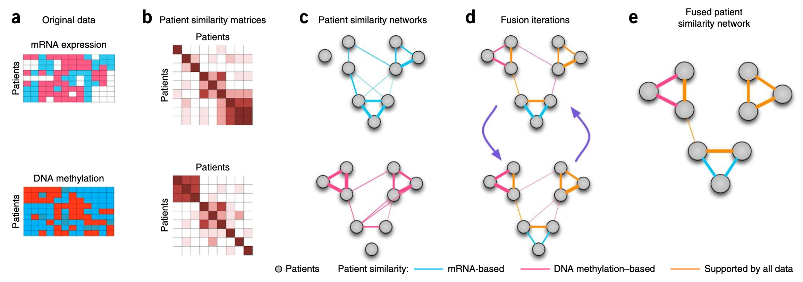

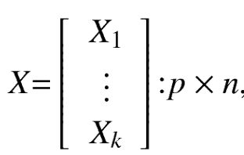
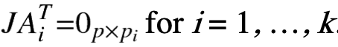
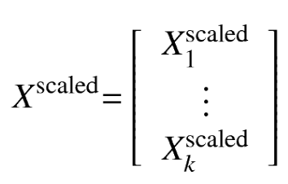
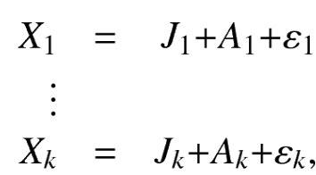
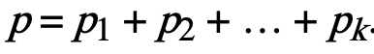

Parallel Multi-Omics Integration
Similarity Network Fusion method (SNF) uses networks of samples as a basis for integration to cluster the samples.
LECTURE 2: Clustering of Samples (MOVICS)
Instructor: Sierra Niemiec
Joint and Individual Variation Explained (JIVE) decomposes the concatenated data into a sum of three terms: (1) joint structure between data types; (2) structure individual to each data type; (3) residual noise.
LECTURE 3: Dimension Reduction (JIVE)
scale
decompose
Concatenate data matrices from K platform
joint structure matrix of rank r
individual structure of rank $r_{i}$
Instructor: Jack Pattee
Wang et al. (2014) Nat Methods; Lock et al. (2013) The Annals of Applied Statistics

Slide 22
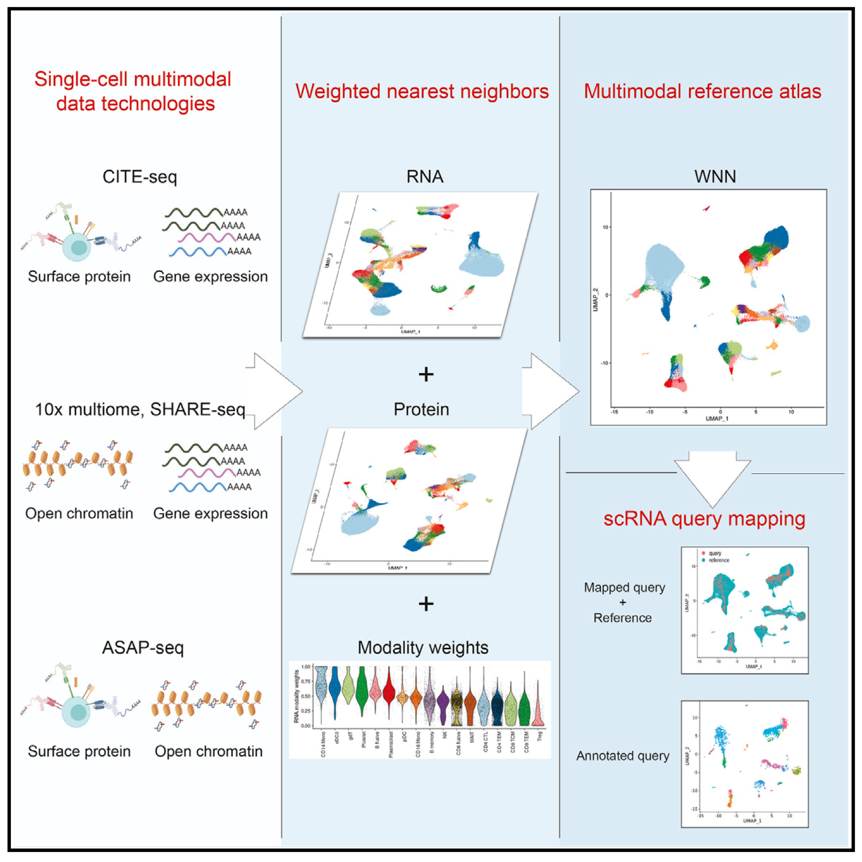

Parallel Multi-Omics Integration
LECTURE 4b: Single-cell Multi-Omics Analysis (Seurat)
Instructor: Rick Chang
Hao et al. (2021) Cell

Slide 23
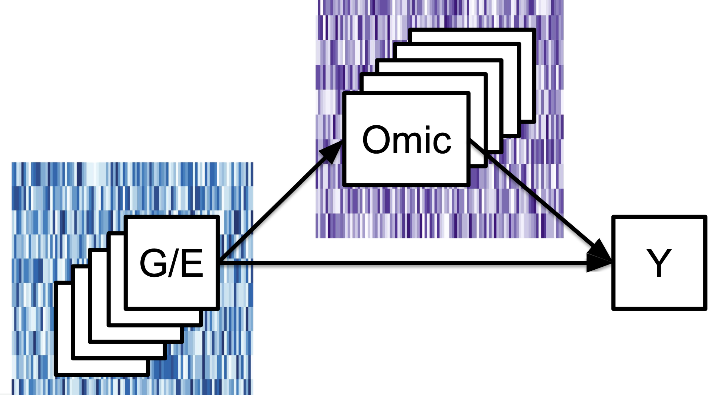
Hierarchical Multi-Omics Integration
Transcriptomics;
Proteomics;
Metabolomics, etc.
LECTURE 4a: Causal Mediation Analysis for Multi-Omics Analysis
Gene variant;
Regulatory omics (e.g., miRNA);
Exposure, etc.
Outcome
Zhang et al. (2016) Bioinformatics; Song et al. (2020). BAMA. Biometrics.

Slide 24
Outline
Background of Multi-Omics Data Integration
Why integrate omics data?
Multi-omics data source
Common analysis themes and examples
Overview of omics data integration
Methods for Vertical Multi-Omics Data Integration
Parallel integration approaches
Hierarchical integration approaches
Horizontal Omics Data Integration
Lab Session: MetaOmics

Slide 25
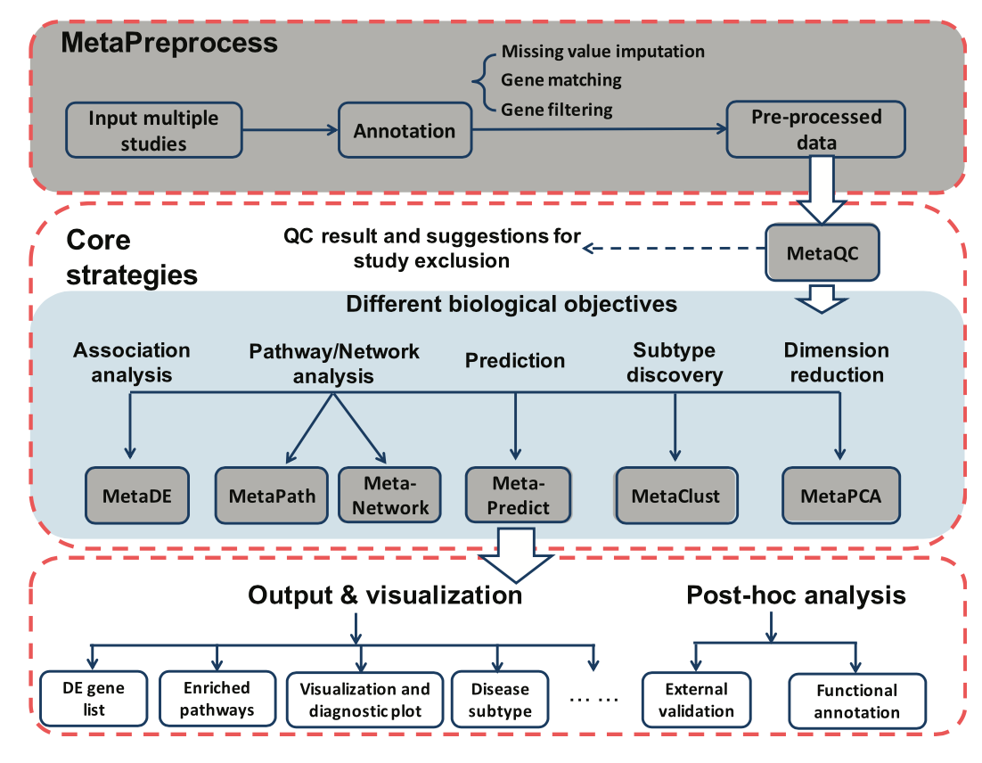
Transcriptomic meta-analysis pipeline and browser-based software suite: MetaOmics
K transcriptomic datasets
D₁
D₂
….
D_{K}
G genes×
S₁ samples
G genes×
S₂ samples
G genes×
S_{K} samples
Ma et al. (2019) Bioinformatics.

Slide 26
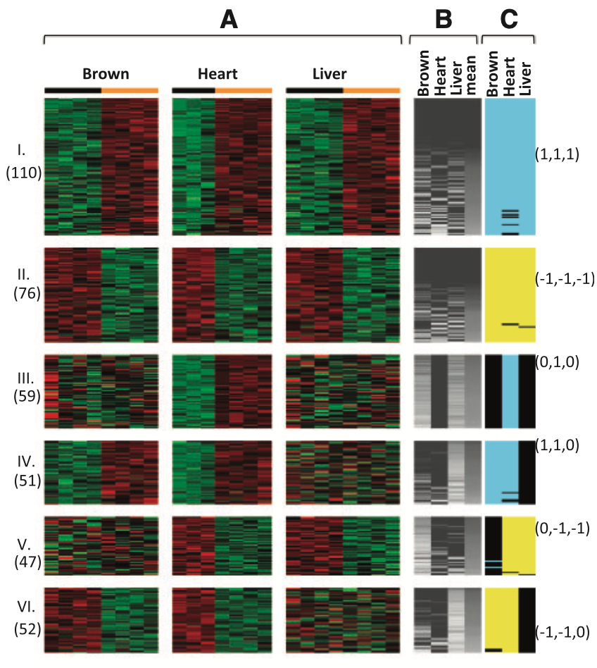
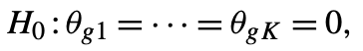
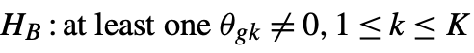
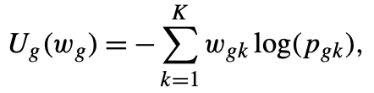
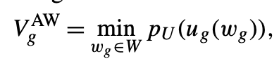
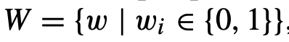

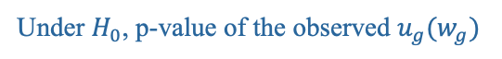
MetaOmics Pipeline: MetaDE
Adaptively Weighted Fisher (AWFisher) method is one of the p-value combination methods that can additionally characterizes which study contributes to the meta-analysis result.
effect size
Hypothesis Setting
p-value of gene $g$ in study $k$
Weighted statistic
Under $H_{0}$, p-value of the observed $u_{g}(w_{g})$
AWFisher statistic
The resulting weight reflects whether a study contributes to the statistical significance of a gene.
The AWFisher p-values are calculated for each gene, followed by FDR control.
Huo et al. (2020) Bioinformatics.

Slide 27
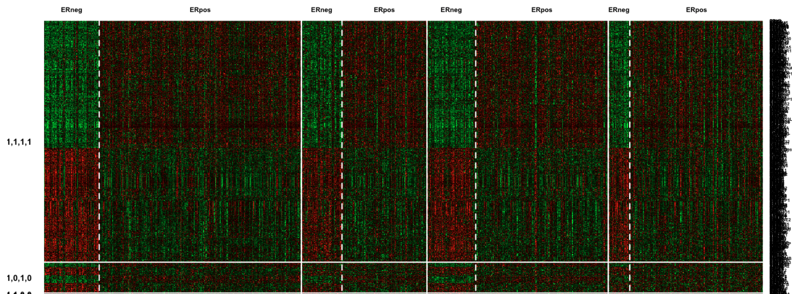
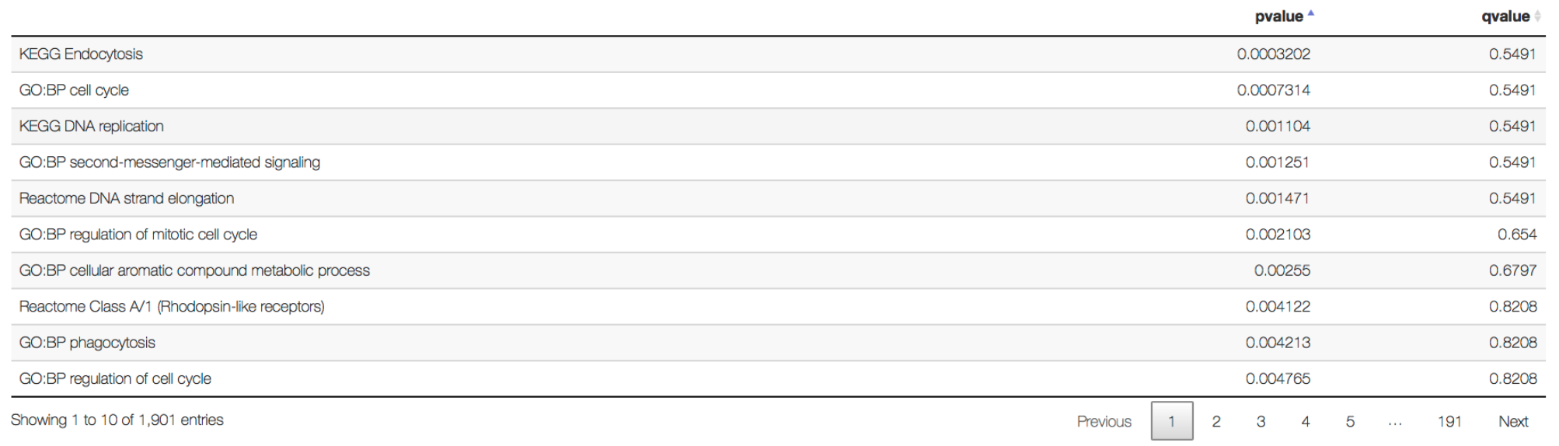
MetaOmics Pipeline: MetaDE
Input: merged individual transcriptomic datasets (microarray or RNAseq) after preprocessing module.
Options of 12 major meta-analysis methods (e.g. AWFisher) with 22 variations for detecting DE genes.
Also implement a post hoc pathway enrichment analysis to functionally annotate detected DE genes.
Huo et al. (2020) Bioinformatics.

Slide 28
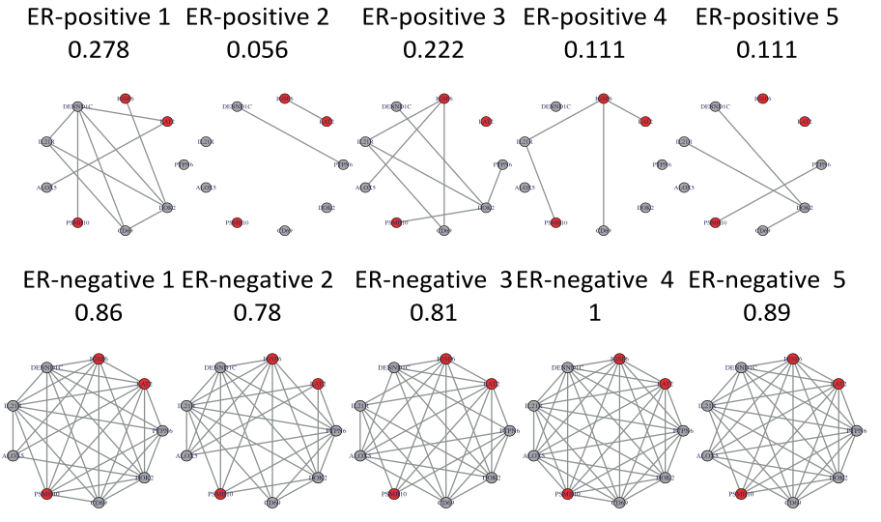
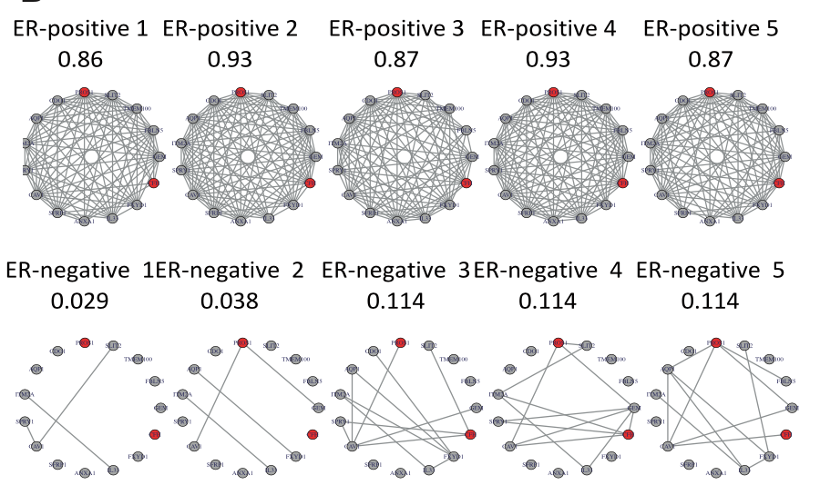
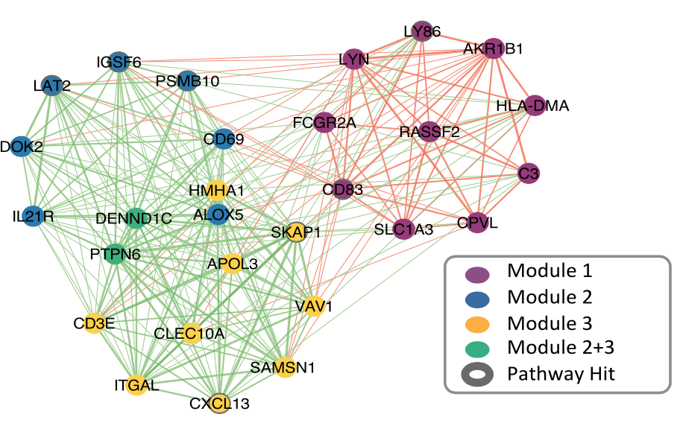
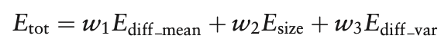
MetaOmics Pipeline: MetaNetwork
MetaDCN method: constructs the Differential Co-expression Networks (DCN)
Generate co-expression network
Search for basic DCN modules
Assemble the basic DCN modules into super-modules
Mean network density difference between outcome groups across all studies
Size of the module
Consistency of the density difference between outcome groups across studies
Zhu et al. (2017) Bioinformatics.

Slide 29
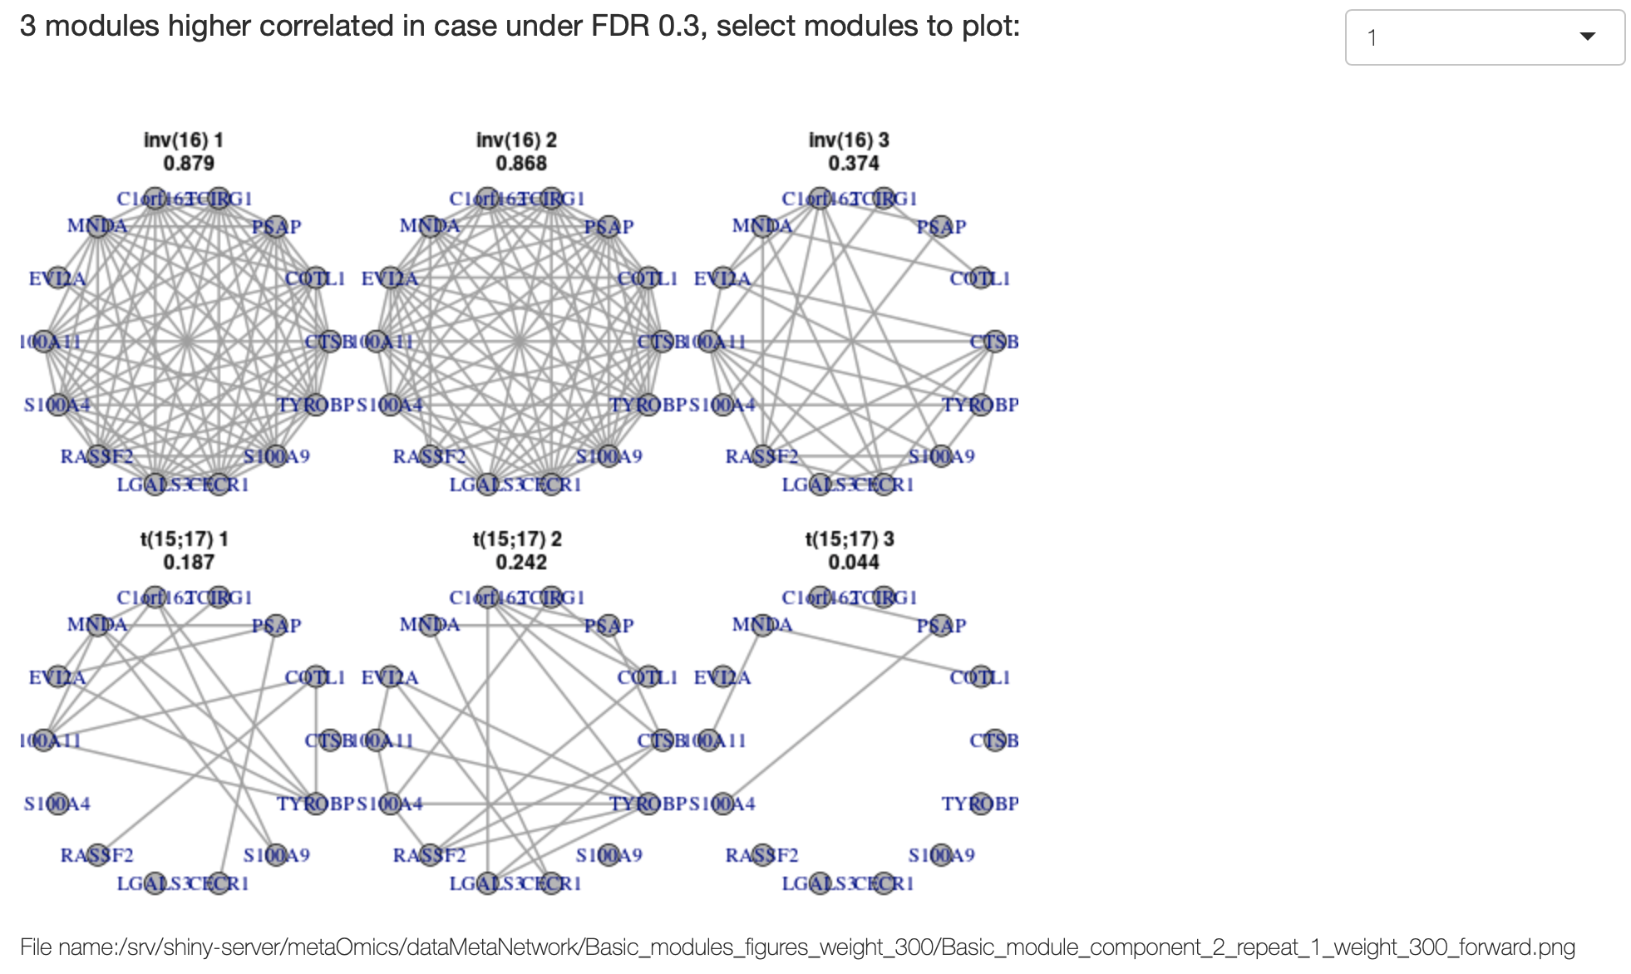
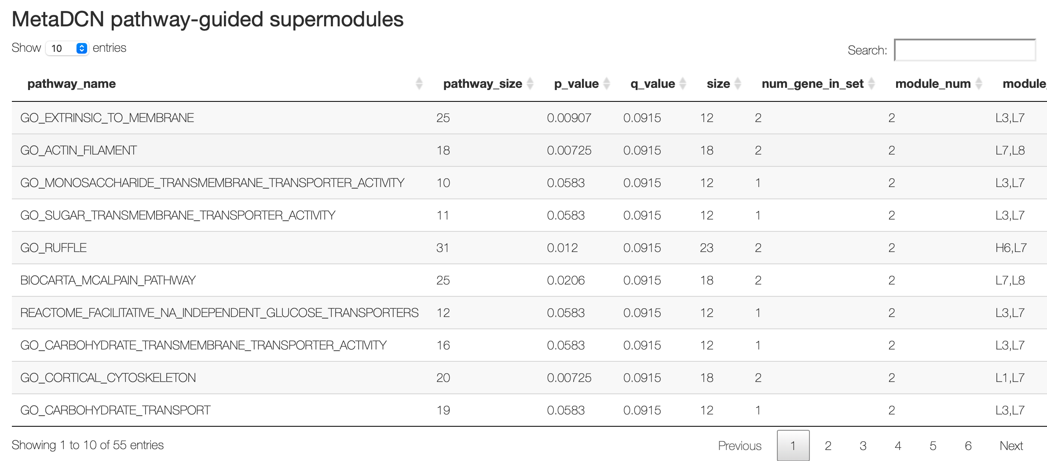
MetaOmics Pipeline: MetaNetwork
Input: merged individual transcriptomic datasets after preprocessing module.
GOAL: infer whether the gene-gene correlations change between outcome groups.
Implement MetaDCN method to construct the basic differential co-expression networks (DCN) and assemble the significant basic DCN modules into pathway-guided super-modules.
The result of super-modules can be uploaded to a Cytoscape App “MetaDCNExplorer” for interactive visualization.
Study 1
Study 2
Study 3
0.879
0.868
0.374
Group 1:
Inversion on Chr16
0.187
0.242
0.044
Group 2:
Translocation between Chr15 and Chr17

Slide 30
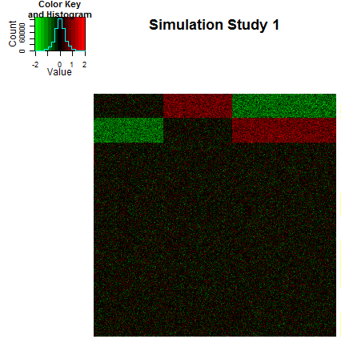
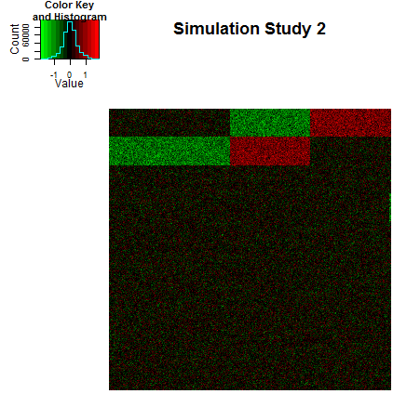
MetaOmics Pipeline: MetaClust
MetaSparseKmeans
150 patients
200 patients
I
II
III
I
III
II
Gene set 1: (0,+,-)
Gene set 2: (-,0,+)
Gene set 3: (0,0,0)
Three parameters to estimate:
Gene selection: genes that participate in the clustering
Sample clustering: Sample assignment to clusters
Pattern matching: Match cluster patterns across studies

Slide 31
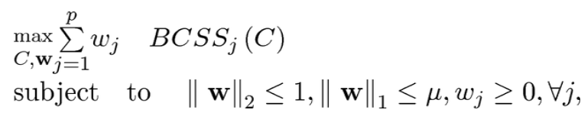
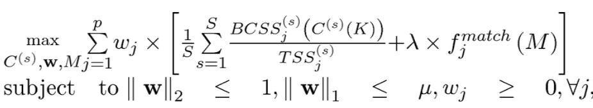
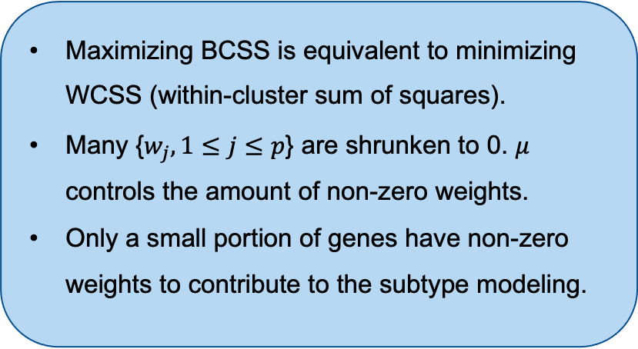
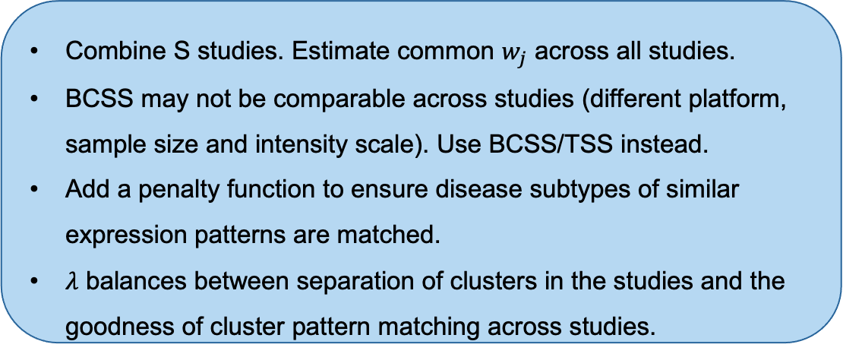
MetaOmics Pipeline: MetaClust
MetaSparseKmeans method extends the sparse K-means method towards a meta-analytic framework.
Sparse K-means for single study
Meta Sparse K means for s studies
between-cluster sum of squares
Gene selection
Sample separation
Pattern matching
lasso regularization on gene-specific weights
Maximizing BCSS is equivalent to minimizing WCSS (within-cluster sum of squares).
Many {$w_{j}, 1≤j≤p$} are shrunken to 0. $μ$ controls the amount of non-zero weights.
Only a small portion of genes have non-zero weights to contribute to the subtype modeling.
Combine S studies. Estimate common $w_{j}$ across all studies.
BCSS may not be comparable across studies (different platform, sample size and intensity scale). Use BCSS/TSS instead.
Add a penalty function to ensure disease subtypes of similar expression patterns are matched.
$λ$ balances between separation of clusters in the studies and the goodness of cluster pattern matching across studies.
Huo et al. (2016) JASA.

Slide 32
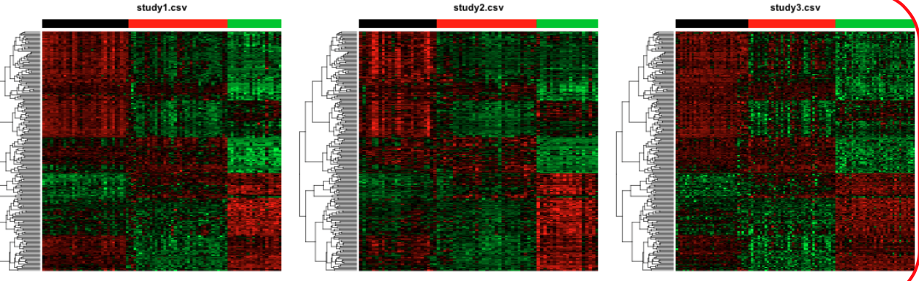
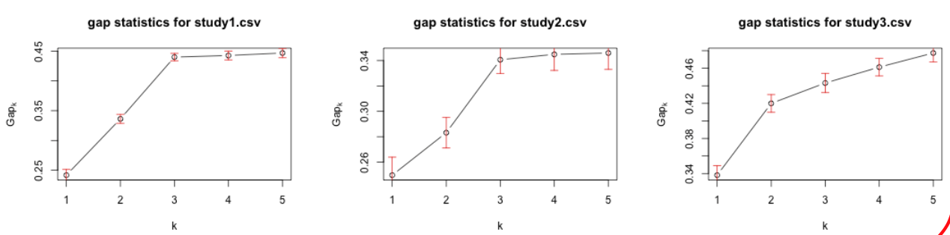
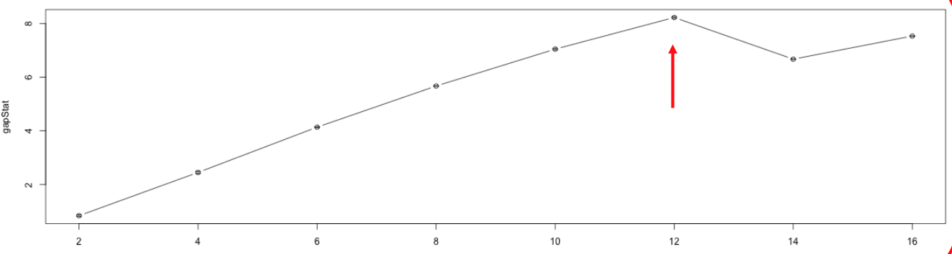
MetaOmics Pipeline: MetaClust
Implement MetaSparseKmeans method to cluster samples and select the “intrinsic gene” set.
Optionally tune the parameters before clustering by gap statistic: the number of clusters (K) and the regularization parameter (Wbounds).

Slide 33
Module | Methods
MetaPreprocess | Upload individual studies Four preprocessing steps: gene annotation, missing value imputation (if needed), gene matching and preliminary gene filtering
MetaQC (quality control) | Utilizes six quantitative QC measures: IQC, EQC, AQCg and CQCg, as well as AQCp and CQCp to make inclusion/exclusion decision
MetaDE (differential expression analysis ) | Combining effect sizes | fixed effects model (FEM) six variations of random effects model (REM)
 | Combining p-values | Fisher, Stouffer, adaptively weighted Fisher (AW-Fisher), minimum p-value (minP), maximum p-value (maxP) and rth ordered p-value (rOP) and their one-sided correction variations
 | Combining ranks | sum of ranks, product of ranks (PR) and RankProd
 | Multi-class meta analysis | minimum multi-class correlation (minMCC) method
MetaPath (pathway enrichment analysis ) | Meta-Analysis for Pathway Enrichment (MAPE) (Shen and Tseng, 2010 Bioinformatics) Comparative Pathway Integrator (CPI) (Zeng, 2018 Genes)
MetaNetwork (differential co-expression network analysis) | MetaDCN method (Zhu, et al. 2017 Bioinformatics) to integrate multiple transcriptomic studies for differential co-expression networks (DCN) detection.
MetaPredict (differential co-expression network analysis) | MetaKTSP method (Kim, et al. 2016 Bioinformatics)
MetaClust (clustering analysis) | MetaSparseKmeans algorithm (Huo, et al. 2016 JASA)
MetaPCA (dimension reduction) | MetaPCA method (Kim, 2018 Bioinformatics): sum of variance (SV) decomposition and sum of squared cosines (SSC) decomposition

Slide 34
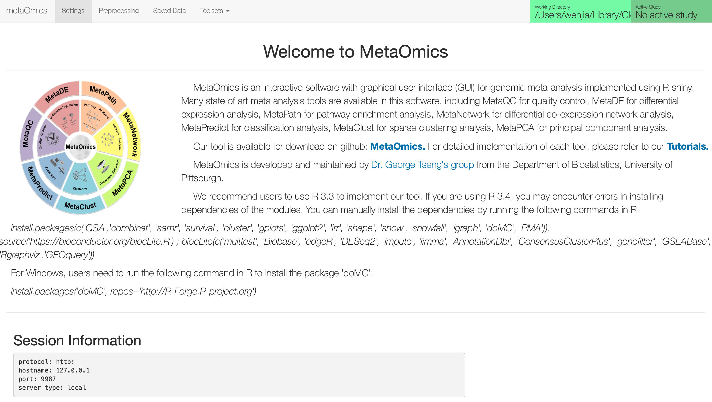
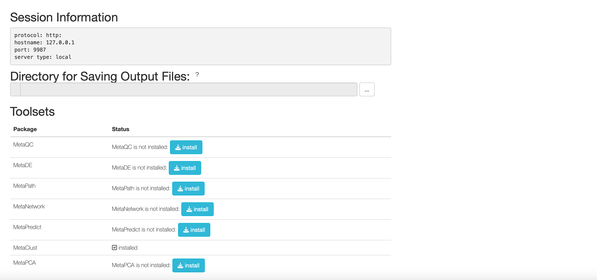
Lab Session: MetaOmics

Slide 35
General biological insights:
Gligorijevic and Przulj (2015) Methods for biological data integration: perspectives and challenges. J R Soc Interface.
Hasin et al. (2017) Multi-omics approaches to disease. Genome Biology.
Huang et al. (2017) More Is Better: Recent Progress in Multi-Omics Data Integration Methods. Frontiers in Genetics.
Dihazi et al. (2018) Integrative omics - from data to biology. Expert Review of Proteomics.
Misra et al. (2019) Integrated omics: tools, advances and future approaches. Journal of Molecular Endocrinology.
Noor et al. (2019) Biological insights through omics data integration. Current Opinion in Systems Biology.
Wang et al. (2019) Toward multiomics-based next-generation diagnostics for precision medicine. Personalized Medicine
Mathematical/statistical challenges:
Richardson, Tseng and Sun. (2016) Statistical Methods in Integrative Genomics. Annual Review of Statistics and Its Application.
Bersanelli et al. (2016) Methods for the integration of multi-omics data: mathematical aspects. BMC Bioinformatics
Wu et al. (2019) A Selective Review of Multi-Level Omics Data Integration Using Variable Selection. High Throughput.
Machine learning perspective:
Li et al. (2019) A review on machine learning principles for multi-view biological data integration. Briefings in Bioinformatics.
Zitnik et al. (2019) Machine learning for integrating data in biology and medicine: Principles, practice, and opportunities. Information Fusion.
Mirza et al. (2019) Machine Learning and Integrative Analysis of Biomedical Big Data. Genes.
Rappoport and Shamir (2018) Multi-omic and multi-view clustering algorithms: review and cancer benchmark. Nucleic Acids Research.

Slide 36
Specialized disease areas:
Zhang et al. (2010) Integrating multiple ‘omics’ analysis for microbial biology: application and methodologies. Microbiology
Sathyanarayanan et al. (2019) A comparative study of multi-omics integration tools for cancer driver gene identification and tumour subtyping. Briefings in Bioinformatics.
Chakraborty et al. (2018) Onco-Multi-OMICS Approach: A New Frontier in Cancer Research. BioMed Research International. Canzler et al. (2020) Prospects and challenges of multi-omics data integration in toxicology. Archives of Toxicology.
Beltran et al. (2017) Proteomics and integrative omic approaches for understanding host–pathogen interactions and infectious diseases. Molecular Systems Biology.
Sun and Hu (2018) Integrative Analysis of Multi-omics Data for Discovery and Functional Studies of Complex Human Diseases.
Donovan et al. (2019) The current state of omics technologies in the clinical management of asthma and allergic diseases. Ann Allergy Asthma Immunol.
Higdon et al. (2015) The Promise of Multi-Omics and Clinical Data Integration to Identify and Target Personalized Healthcare Approaches in Autism Spectrum Disorders. OMICS: A Journal of Integrative Biology.
Specific community-centered:
Pinu et al. (2019) Systems Biology and Multi-Omics Integration: Viewpoints from the Metabolomics Research Community. Metabolites.
Zhang and Kuster (2019) Proteomics Is Not an Island: Multi-omics Integration Is the Key to Understanding Biological Systems. Molecular & Cellular Proteomics.
Single cell multi-omics:
Chappell et al. (2018) Single-Cell (Multi)omics Technologies. Annual Review of Genomics and Human Genetics.
Hu et al. (2018) Single Cell Multi-Omics Technology: Methodology and Application. Front. Cell Dev. Biol.

Slide 37
Thank you!

